Slide 1
Goodreads Reviews on Children’s Books
Group 4 (Goh Chen Ling Beatrice, Kevin Magic Rialubin Sunga,
Koh Jun Jie, Wong Kian Hoong Andy)

Slide 2
Agenda
Introduction
Solution Overview
Solution Details
Results & Analyses
Discussion & Gap Analyses
Future Work
Conclusion
Demo

Slide 3
Introduction
Motivation:
Parents want to find good books to introduce to their children
Schools & libraries would like to procure popular and recommended books for students
Publishers want to evaluate the popularity & performance of their books
Data Source:
We analysed reader’s reviews of top 10 most reviewed children’s books on Goodreads (about 28,900 reviews)
Notes:
Goodreads is an American social cataloging website that allows individuals to search its database of books, annotations, quotes, and reviews. Users can sign up and register books to generate library catalogs and reading lists.

Slide 4
Solution Overview
Data Preparation
Load dataset & libraries
EDA
Filter for Top 10 most reviewed
Text
Pre-processing
Topic Extraction
Document Clustering
Information Extraction
Sentiment Analysis
LDA Topic Modelling
K-means Clustering
Association Mining
Sentiment analysis at review level
Results
Aspect Based Sentiment Analysis
Interpret & Evaluate
Notes:
Clustering
Association Mining – NLP task

Slide 5
Topic Extraction

Slide 6
Solution Details – Topic Extraction
Text Pre-processing
LDA Topic Modelling
Punctuation
Stop words removal
POS tagging
Word Tokenization
Sentence Tokenization
Perform 20 models per book
Select optimal k using coherence score
Analyze topics

Slide 7
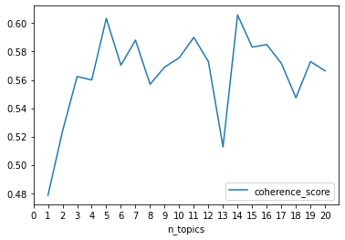
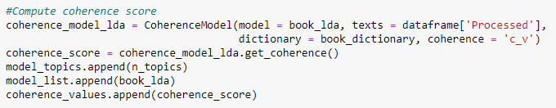
Results & Analysis – Topic Extraction
Optimal k using Coherence Score
The coherence score algorithm works through each of the books and generates 20 models from 1 topic to 20 topics. The graph shows the coherence score. In this case, the model with 14 topics is the optimum.

Slide 8
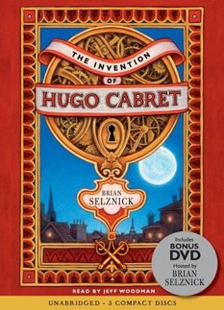
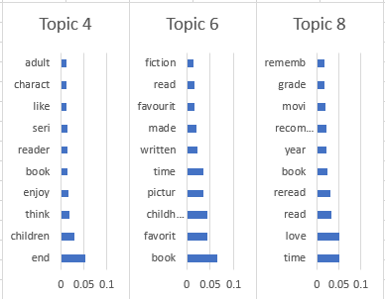
Application – Topic Extraction
Schools and libraries may analyse the topics for this title to assess its suitability as a book for children.
Topic 4: Children may enjoy this book.
Topic 6: A favourite childhood book.
Topic 8: Love the book and reread it. It was made into a movie.
It may be a suitable book for children, and with a movie made of it, it may increase a child’s interest to read the book after watching the movie.

Slide 9
Document Clustering

Slide 10
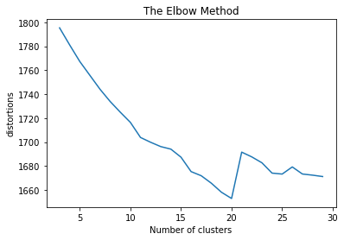
Solution Details – Document Clustering
Text Pre-processing
K-Means Clustering
Text Cleaning
Remove websites, emoticons
Stop words & rare words removal
Word Tokenization
POS tagging
Selection of Nouns and Verbs only
Stemming
Convert stemmed tokens into vectors
Run K-Means clustering algorithm for 3 to 30 clusters
Select based on elbow method and visualise output
View topic words and present intepret data

Slide 11
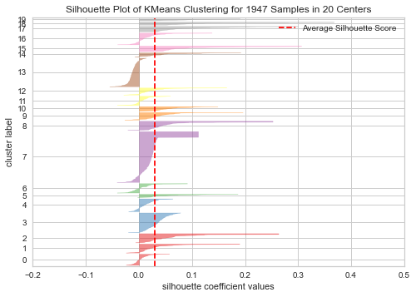
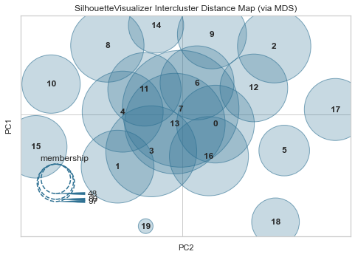
Results & Analysis – Document Clustering
High level of noise
K-Means labelling noises into incorrect clusters

Slide 12
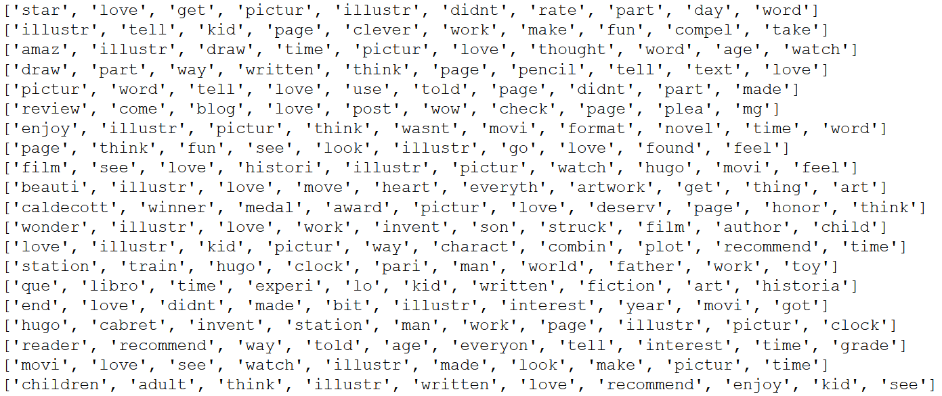
Results & Analysis – Document Clustering
Summary
Some overlapping words between clusters
K-means unable to classify noise accurately
Reviewers love the illustration
The movie of the book is a critically acclaimed piece
The illustration is recommended for both children and adults

Slide 13
Application – Document Clustering
Books get reviewed on Goodreads
Goodreads provide overview for reader comments
Reduce time required by publisher to get feedback on their books
Accurate and raw feedback posted anonymously
Subscription based model where publishers pay for access to detailed information
Publishers gain feedback quickly and able to advise authors on future works

Slide 14
Sentiment Analysis

Slide 15
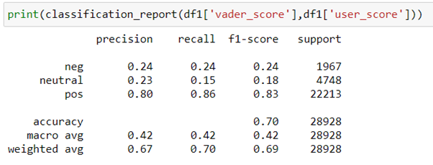
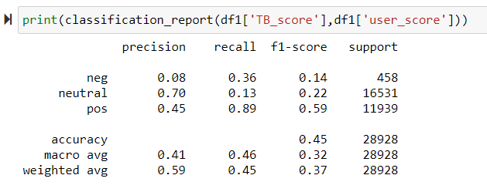
Results & Analysis – Sentiment Analysis
User Rating (“golden truth”) compared with Vader compound score & TextBlob polarity
 | Negative | Neutral | Positive
User rating | 1,2 | 3 | 4,5
Vader | -1.0 to -0.31 | -0.3 to +0.3 | +0.31 to +1.0
TextBlob | -1.0 to -0.31 | -0.3 to +0.3 | +0.31 to +1.0

Slide 16
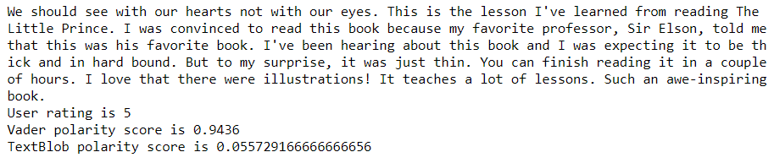
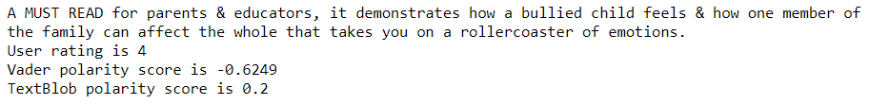
Results & Analysis – Sentiment Analysis
When sentiment packages perform well…..
When sentiment packages do not perform as expected…..

Slide 17
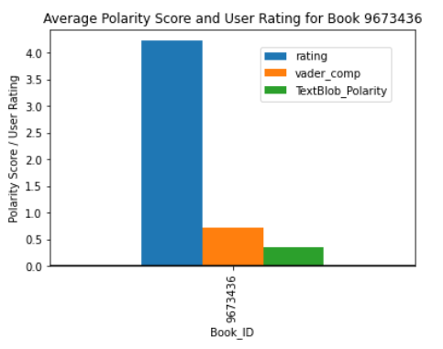

Application – Sentiment Analysis
Overall sentiment is positive.
“My three year old loved, LOVED, this book so much that afterwards we started role playing, with me as the Station Inspector and him as Hugo Cabret. Highly recommend.”
User rating – 4
Vader compound score – 0.0
TextBlob polarity – 0.0533
“The juxtaposition prose/picture made this book really magical and charming… if I had a kid, this would be at the top of my list to read him/her.”
User rating – 5
Vader compound score – 0.9436
TextBlob polarity – 0.0557

Slide 18
Association Mining

Slide 19
Results & Analysis – Association Mining
Example output:
=====================================
Rule: ('adult', 'NN') -> ('child', 'NN')
Support: 0.0019346269346269347
=====================================
Rule: ('story', 'NN') -> ('adult', 'NN')
Support: 0.0011068761068761068
=====================================
Rule: ('story', 'NN') -> ('age', 'NN')
Support: 0.0012993762993762994
=====================================
Rule: ('spoiler', 'NN') -> ('alert', 'NN')
Support: 0.0039751289751289755
=====================================
Rule: ('author', 'NN') -> ('story', 'NN')
Support: 0.0020693770693770695
=====================================
Rule: ('way', 'NN') -> ('author', 'NN')
Support: 0.0010683760683760685
=====================================
In total, the Apriori algorithm found 95 rules with a min_support of 0.001.
From 95 rules, we extracted 7 aspects:
Story, writing, style, character, point, plot, message
5 out 10 of the top rules contained an aspect
1 out 10 of the bottom rules contained an aspect
Notes:
Inspired by Hu and Liu (2004), we used the Apriori algorithm to perform Association Mining to extract aspects.
Citation: https://dl.acm.org/doi/10.1145/1014052.1014073
Support is an indication of how frequently the itemset appears in the dataset.

Slide 20
Aspect and Sentiment Extraction

Slide 21
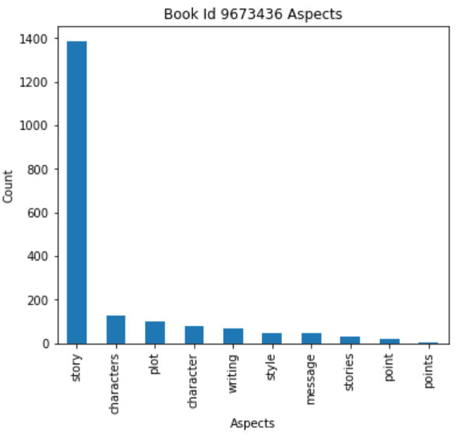
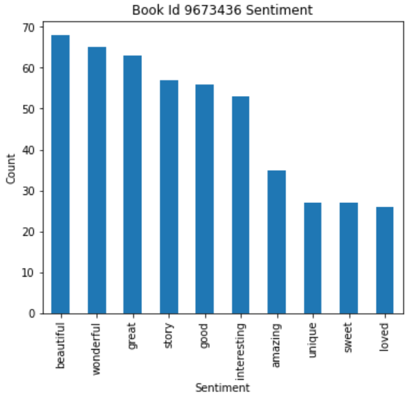
Results & Analysis – Aspect and
Sentiment Extraction
“Story” is mentioned the most out of all aspects. This suggests that readers likely held an opinion about the book’s story.
The top extracted sentiments are “beautiful”, “wonderful”, and “great” which suggests that readers may have felt positively about the aspects in the book.
Figure: Top Aspects
Figure: Top Sentiments

Slide 22
Results & Analysis – Aspect and
Sentiment Extraction
Sentence | Human Aspect | Human Opinion | Machine Aspect | Machine Opinion
"Rowling's plots are getting tighter and tighter and this one is no exception with great surprises in the last chapters.", | plots | tighter | plots | getting
'It introduces Sirius Black and Remus Lupin who are some of my favorite characters.', | characters | favorite | characters | favorite
"The story keeps getting better and better, and one can't help but be happy to enter that world once again and keep fighting the dark wizard!", | story | better | story | keeps
"I know it would hurt the plot a lot, but I think Rowling shouldn't have made something so powerful.", |  |  | plot | hurt
'His tenderness is apparent, in the fact that unlike most of the characters, he never "shouts," only patiently inquires.' |  |  | characters | apparent
50% extracted correctly (25 / 50)
50% extracted incorrectly (25 / 50)
Works well on simple sentences but fails on complex sentences and sentences where no sentiment should be extracted
Improve rule definitions for better accuracy
Notes:
N total: 50
N human: 35
N machine: 46
N matched: 22

Slide 23
Sentiment Analysis

Slide 24
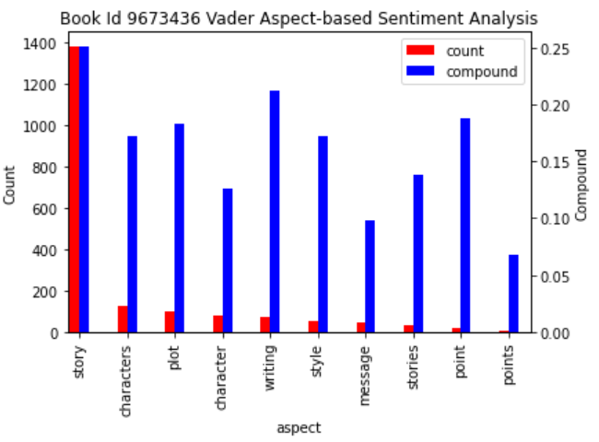
Results & Analysis – Sentiment Analysis
Average sentiment for each of the top 10 aspects are neutral (-0.3 to +0.3).
A possible explanation for the neutral sentiment is the low accuracy from aspect and sentiment extraction. A large number of non-sentiment words may be decreasing the average sentiment.
Figure: Top Aspects and Vader sentiment

Slide 25
Results & Analysis – Sentiment Analysis
Confusion Matrix
N=50 | Precision | Recall | F1
Positive | 1 | 0.59 | 0.74
Neutral | 0.08 | 1.00 | 0.14
Negative | 0.67 | 0.50 | 0.57
Na | 0.75 | 0.20 | 0.32
High precision on positive but lower recall. Positive sentiments are getting misclassified as neutral.
Precision on neutral is very low. Most should be na because the extracted sentiment was erroneous.
Observations
 |  | Human
Machine | N=50 | Pos | Neu | Neg | na
 | Pos | 17 | 0 | 0 | 0
 | Neu | 11 | 2 | 2 | 11
 | Neg | 0 |  | 2 | 1
 | na | 1 | 0 | 0 | 3
Notes:
Na is when no sentiment was extracted b/c no aspect sentiment was in the sentence or extracted by the machine

Slide 26
Application – Sentiment Analysis
Although the accuracy and results of our Aspect-Based Sentiment Analysis aren’t as good as we would’ve liked, we were able to extract some insights:
The most mentioned aspect in children’s books reviews is “story”. Therefore, publishers might further emphasize the relative importance and evaluation of stories against other aspects in signing book deals.
For book id 5, the most mentioned aspect is “character”. Thus, for parents who want character driven book for their child, this book might be a good choice.

Slide 27
Challenges and Gap Analysis

Slide 28
Challenges & Gap Analysis
Dataset
Very large dataset, need to find a suitable way to filter
Some numbers and URLs present in the reviews
Topic Extraction
Need to further refine stop words list and include frequently occurring words like "book"
Sentiment Analysis
Can mine only on known features
Difficult to mine implicit features
Document Clustering
Association Mining
High degree of overlap in the clusters
Not meaningful results on corpus, clustering repeated at book level
Polarity scores are affected by “noise” (factual descriptions of the story)
Some reviews written in foreign language
Non-language reviews (e.g. “xyzxyz”)
Some misclassification due to “noise” (e.g. review making reference to another book)
Very large and sparse matrix
Some misclassified clusters due to “noise”
Low support and confidence scores given large corpus and document size
Results were affected by “noise” (names of characters were mentioned often)
Difficult to extract features from long sentences

Slide 29
Future work and Conclustion

Slide 30
Future Work & Conclusion
Long reviews contained “noise”, need a better way to filter “irrelevant” content
Dictionary for book reviews to improve classification (e.g. author’s name and character’s name)
Defining better rules to handle complex sentence structure – for extracting aspects for sentiment analysis
Create a method for extracting implicit features for sentiment analysis

Slide 31
Demo

Slide 32
Team Member’s contributions
Data Preparation
All
Load dataset & libraries
EDA
Filter for Top 10 most reviewed
Text
Pre-processing
Andy & Jun Jie
Kevin & Beatrice
Topic Extraction
Document Clustering
Information Extraction
Sentiment Analysis
LDA Topic Modelling
K-means Clustering
Association Mining
Sentiment analysis at review level
Results
All
Aspect Based Sentiment Analysis
Interpret & Evaluate
Notes:
Clustering
Association Mining – NLP task

Slide 33
Appendix

Slide 34
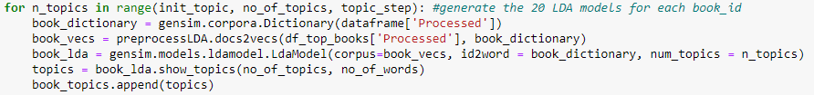
Results & Analysis – Topic Extraction
Sample LDA output
LDA outputs the top n words with the corresponding weighting, for each topic. This is visualized as a bar chart.

Slide 35
Solution Details – Overall Sentiment Analysis
Text Pre-processing
Overall Sentiment Analysis
Removal of URL, hashtags and mentions
Polarity Score - TextBlob
Polarity Score - Vader
Compare against user rating
Confusion Matrix – precision, recall, F-score

Slide 36
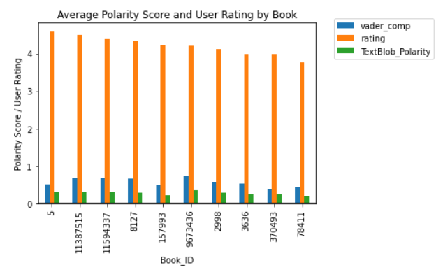
Results & Analysis – Sentiment Analysis
Vader and TextBlob polarity scores compared with User Rating
“I read this because it’s one of my friend’s favourite books - it was excellent, but very upsetting as well.”
User rating – 4
Vader compound score – 0.2038
TextBlob polarity – 0.5667
“I absolutely loved this book. It is not easy to write about a young person with physical disabilities and allow his voice to come through as a regular kid. This book succeeded beautifully”
User rating – 5
Vader compound score – 0.8803
TextBlob polarity – 0.2389

Slide 37
Solution Details – Aspect-Based Sentiment Analysis
Text Pre-processing
Steps
Purpose
Sentence and word Tokenization
Stop word removal
POS tagging—keep only NN words
Lemmatization
Association Mining
What are the most common aspects people talk about in reviews?
What are people saying about aspects in their reviews?
Are the extracted sentiments positive, negative, or neutral?
Aspect and sentiment extraction
Sentiment Analysis

Slide 38
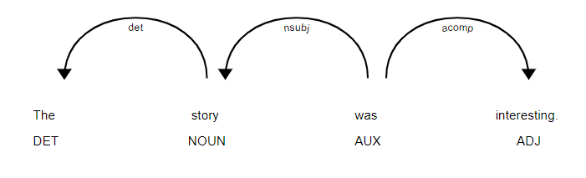
Solution Detail – Aspect and
Sentiment Extraction
Exploit grammar rules to identify aspects and the words that modify them
spaCy Dependency Matcher for aspect and sentiment extraction
Notes:
Displacy rendering

